Slide 1
Sixth Form Open Evening 8th Feb 4:30-6pm

Slide 2
Format for the Evening
Introduction Mr Jones
Mrs Boyd - Careers
Mr Creed – Exams & Intervention
Head of Year Mr Danson
Maths – Mr Martin
English – Mrs Cleary
Science – Mr Gash

Slide 3
Information
This power point slide show will be available on the website tomorrow.

Slide 4
Year 11 Careers Education , Information , Advice and Guidance

Slide 5
Until the age of 18, students have to stay education , employment or training but can choose from a range of options
:
Full-time education, such as school or college.
An apprenticeship.
Part-time education or training with employment
Part-time education or training plus volunteering
Schools have to report students destinations to Local Authority and track

Slide 6
Choices at 16

Slide 7
Careers Support at School
Careers Interview with qualified careers advisors from Career Connect Careers interviews with Mrs Kinder Assistant Headteacher Sixth form Careers interviews with Mrs Boyd Assistant Headteacher Gateacre Sixth form open evening 8th February 2024 Future Focus Fair January 2024 Careers Lessons Civil service Employability sessions with mock interviews Morrisby Careers software support National Careers service Careers drop in each lunch time with Mrs Boyd and Mrs Kinder Career Padlet on Edulink Year Head Mr Danson , Assistant Head of Year Miss Bayly SENCO Volunteering opportunities with National Citizen Service

Slide 8
Careers advice after school
Information on
School Website
Careers Padlet
Careers Drop in After School
Bemore Portal
Morrisby careers
Career Pilot
National Careers Service Website
SACU

Slide 9
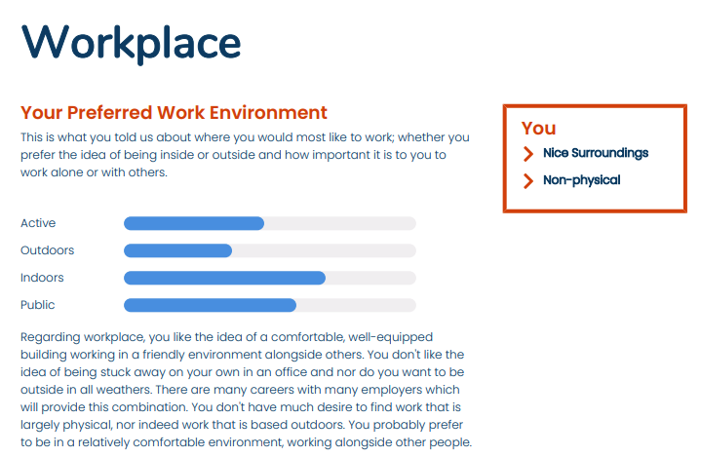

Slide 10
Gateacre Career Padlet – available on Edulink and website

Slide 11
Mr Creed Assistant Headteacher Exams & Intervention

Slide 13
Intervention Sessions - Targeted
English, Maths Science and Geography Intervention classes run each morning Monday – Thursday 8.45am-9.30am.
All students will be in a class for a subject.
Good attendance and punctuality is essential in order to gain the most from the sessions.
All intervention classes are targeted to key students who have specific gaps in knowledge so we can fill the gaps.
Intervention classes targeted not general revision as one size does not fit all.
We have seen a huge improvement in results this summer at GCSE in which the data points to interventions class gains.
After 6 weeks students will change subjects, this format will continue all year.

Slide 14
Y11 Study Support
Each morning Y11 students are encouraged to attend school early at 8am to study in the atrium.
An area will be cordoned off just for studying.
A free breakfast will be provided each day.
Teaching staff will be on hand to support the students.
Departments will provide resources and revision materials.
This is will start in the coming weeks and run until the mock exams initially.

Slide 15
After School Revision
We hope to launch our after school revision class timetable shortly.
Students will be able to see which classes are available on which days.
It will be a 2 week timetable the same as what we operate. E.g. English week one, Maths the second week.
Students are strongly advised to attend so they are revisiting material from last year, which they may have forgotten.
I will contact you when we are ready to go live.

Slide 16
Mock Exams
Mocks - November 20th – 30th.
Mock results Thursday 14th December 3.20pm.

Slide 17
Head of Year 11
Mr Danson

Slide 18
Year 11 HOY/Pastoral
Attendance. Every school day really does count. Research will tell you that by not being in everyday will affect your overall grade and outcomes.
Punctuality-Being late to lessons disrupts the learning of other students and hinders the flow of the lessons.
After School Revision Sessions-Students to start as early as possible.
Revision timetable at home.
Interventions are on-going and take place during Academic Tutor Time
GCSE Pod/PIXL other Apps/websites
Getting Basics Right-Being equipped and ready to learn
Pastoral Support – HOY/AHOY/Form Tutors. We are here for you!
End of year celebrations.

Slide 19
Year 11 HOY/Pastoral
Pastoral support
HOY/AHOY
Form tutors
Subject staff
Additional services – counselling /YPAS
Working collaboratively with each other to support and guide your child.

Slide 20
Mr Martin Head of Mathematics

Slide 21
GCSE Mathematics
EDUQAS exam board
Full details of their specification can be found on www.eduqas.co.uk
2 examinations at the end of year 11
Foundation (1-5) and Higher Tier (3-9)

Slide 22
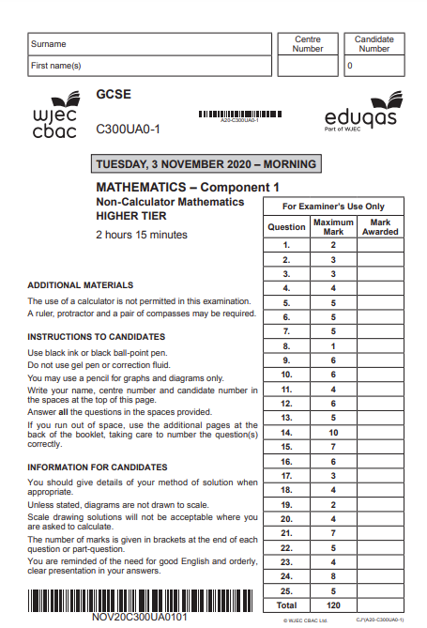
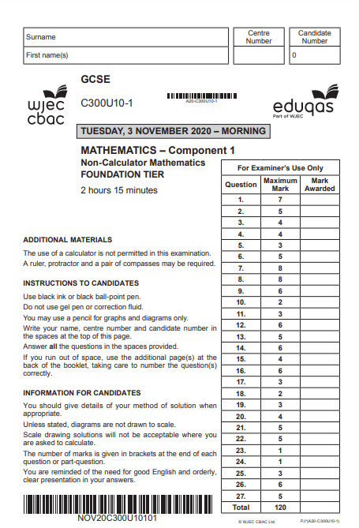
Examinations
Both papers will be marked out of 120
Both will be 2 hours 15 minutes
Both will be a mixture of topics
About 30% crossover topics
Dates TBC

Slide 23
Attendance
Good attendance is defined as any attendance that is 90% or over.
What does that actually mean?
Exactly 90% attendance means 1 day off every two weeks.
Anything lower is classed as Persistently Absent (PA)

Slide 24
Attendance:
2023 good attendance data
2023 PA data
Grades 9-4 | 35%
Grades 9-5 | 16%
Grades 9-7 | 3%
Grades 9-4 | 74%
Grades 9-5 | 48%
Grades 9-7 | 20%

Slide 25
End of Year 10 data
Grades 9-4 | 61%
Grades 9-5 | 45%
Grades 9-7 | 16%
64%
43%
13%

Slide 26
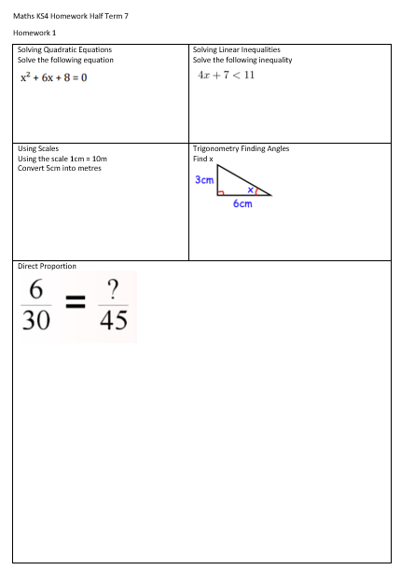
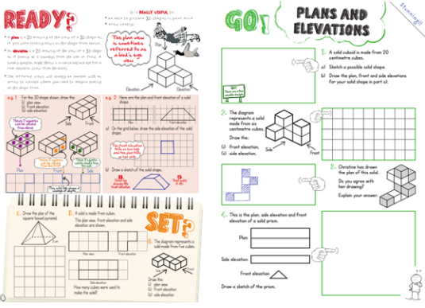
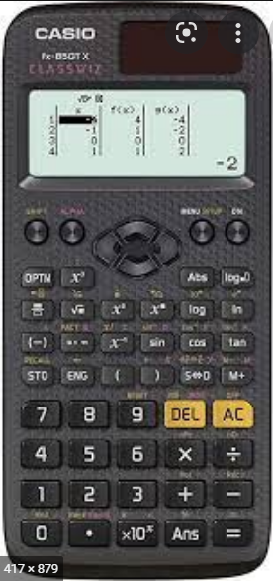
How you can help at home:
Encourage homework is completed on time every week
Encourage use of revision guide at home and before/after school (we are in the process of buying every student one of these)
Quiz your child on definitions, times tables etc and help them keep track of (and celebrate!) their progress
Ask them about topics they need to work on from their weekly Retrieval Quizzes in class.
Provide a quiet place for them to work independently at home.
Purchase a calculator Casio fx-85gtx (about £12)
Please consult us before thinking about a tutor!

Slide 27
Additional support available in school
Targeted morning intervention classes.
Targeted one to one meetings.
Additional support from members of the maths department (doesn’t have to be their teacher!)
Weekly after school revision on a Wednesday.
Whole department exam practice from January.

Slide 28
Supporting learning
Revision guide
Corbett Maths website – free resource
BBC Bitesize - http://www.bbc.co.uk/education/subjects/zrkw2hv
Dr Frost Maths website – free resource

Slide 29
Y11 Parents Information Evening
GCSE English Language & GCSE English Literature

Slide 30
Y 11 English
Your child is being prepared for 2 GCSE qualifications in English lessons: GCSE English Language and GCSE English Literature.
We follow EDUQAS specifications. You can access full details of the exam syllabus for each qualification on their website www.eduqas.co.uk
Results will reported on the 1-9 grading system, introduced for English qualifications in August 2017.

Slide 31
GCSE English Language Summary of Assessment
2 examinations (1 x 1 hour 45 minutes; 1 x 2 hours)
1 compulsory spoken language presentation
No centre assessed written coursework or controlled assessment
Skills based assessment – all texts are unseen
Mock examination in November 2023

Slide 32
Why is English so important?
GCSE English Language is an important foundation for many of the courses your child may take in employment or further education, and is a requirement for many university courses.
It is a core subject, which helps you to develop powers of self-expression and improve your reading and writing
Regardless of the career your child wished to pursue, or the subject they want to study, the majority of employers, training courses and universities look for at least a grade 4 or 5 in English and maths.

Slide 33
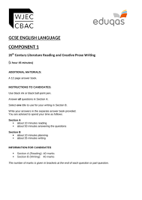
What Do We Study for the English Language Exam?
Passing the English Language exam requires candidates to demonstrate their mastery of reading and writing. We study the following topics intensely:
Use of standard English
Creative reading
Fictional texts
Literary non-fiction texts
Non-fiction texts
Descriptive/narrative writing
Extended Transactional writing: formal letters; informal letters; leaflets; articles; reports; reviews
Presenting
Responding to questions & feedback

Slide 37
GCSE English Literature Summary of Assessment
2 examinations (1 x 2 hours; 1 x 2 hours 30 minutes)
No centre assessed written coursework or controlled assessment
Knowledge and skill-based assessment
Mock examination in March 2024
4 set texts:
Macbeth, William Shakespeare
An Inspector Calls, J B Priestley
The Strange Case of Dr Jekyll and Mr Hyde, Robert Louis Stevenson
EDUQAS Anthology of poetry

Slide 38
Section A (20%) Shakespeare
Set Text: Macbeth
One extract question and one essay question based on the reading of a Shakespeare
Learners are not permitted to take copies of the set texts into the examination.
Section B (20%) Poetry from 1789 to the present day
Two questions based on poems from the WJEC Eduqas Poetry Anthology, one of which involves comparison.
Learners are not permitted to take a copy of the anthology into the examination.

Slide 39
Section A (20%) Post-1914 Prose/Drama
One source-based question on a post 1914 prose/drama text
Set text: An Inspector Calls (Priestley)
Learners are not permitted to take copies of the set texts into the examination.
Section B (20%) 19th Century Prose
One source-based question on a 19th century prose text
Set text: The Strange Case of Dr Jekyll and Mr Hyde (Stevenson)
Learners are not permitted to take copies of the set texts into the examination.
Section C (20%) Unseen Poetry from the 20th/21st Century
Two questions on unseen poems, one of which involves comparison.

Slide 40
How Do I Pass the GSCE English Exams?
There is no denying that passing the GSCE English language and literature exams can be challenging.
Students generally do well when they:
have good attendance in lessons;
try their best in lessons and listen carefully;
respond to teacher feedback and advice on how to improve;
learn key quotations from the GCSE English Literature set texts;
ask for help when they are uncertain of something;
study outside of lessons by re-reading set texts; using revision materials and knowledge organisers; using online resources, such as Educake, GCSE Pod and BBC bitesize; practising exam technique by completing past papers in timed conditions.

Slide 41
read widely outside of lessons: novels, non-fiction texts, newspapers, magazines, online digital publications and blogs;
believe in themselves and their ability to shape their own futures.
Although the GCSE English Exams are not easy to pass, they are immensely important to a person’s academic and professional life. This is why every student should make every effort to ensure they do well in the exam.
A little and often approach to study helps to make exams manageable.

Slide 42
How can I help at home?
Ensure good punctuality and attendance.
Read the set texts and discuss them with your child.
Watch film adaptations of the set texts together.
Provide a quiet place to work and revise.
Try to help develop healthy routines that allow for both study and leisure time, including rest and sleep.
Encourage your child to read widely from a range of fiction and non-fiction texts. Newspapers, magazines and leaflets, which you may have at home, are a great source of material for revising how to write articles, leaflets and guides.
Proof-read homework together to check for errors in spelling, punctuation and grammar.
Help compile a list of words your child has difficulty spelling and test regularly.

Slide 43
Help draw up a realistic revision plan (see department suggestions).
Look through revision materials together
Help with the memorising of quotations from the set texts
Condense notes onto flash cards to act as revision prompts.
Time your child's attempts at practice exam tasks and past papers.

Slide 44
Additional support available in school
Department revision materials and recommended revision schedule
GCSE English Rewards Scheme
Weekly teacher assigned Educake quizzes
Morning intervention classes
Class teacher interventions
Student GCSE Pod account
After school revision sessions

Slide 45
Useful Websites
https://www.gcsepod.com
https://www.educake.co.uk/
https://www.bbc.co.uk/bitesize/examspecs/zpxh82p
(GCSE English Language)
https://www.bbc.co.uk/bitesize/examspecs/zw9mycw
(GCSE English Literature)
http://www.sparknotes.com/

Slide 46
Mr Gash Head of Science
d.gash@gateacre.org

Slide 47
GCSE Combined Science
AQA GCSE Combined Science: Trilogy
6 examinations at the end of Y11.
It is worth 2 GCSEs so they should spend twice as much time on it!
Separate Sciences – 3 Separate Single Grades 9-1. - AQA GCSE Biology - AQA GCSE Chemistry - AQA GCSE Physics

Slide 48
GCSE Science Exams
Combined Science Higher tier – Grades 4-3 upwards Foundation – Grades 5-5 downwards
Separate Sciences Higher Tier – Grade 4 upwards Foundation – Grade 5 downwards

Slide 49
Examinations
6 External Science exams run from Friday 10th May to Friday 14th June.
Each paper is 75 minutes long (1h 45 mins for SS) and is marked out of 70 marks (100 marks for SS).
Each paper will assess the pupils ability to ‘work scientifically’ (15% of questions) and use Numeracy effectively (20% of questions).

Slide 50
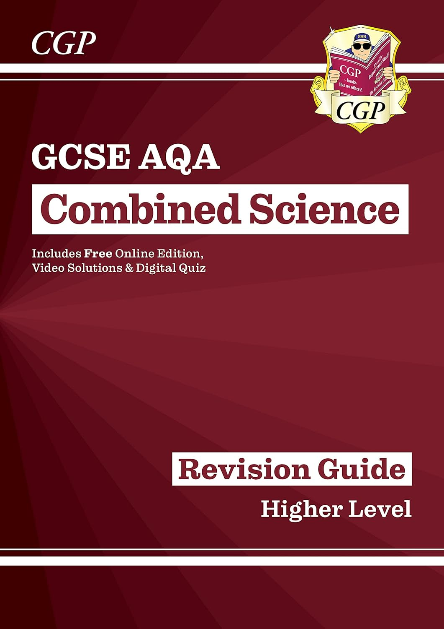
Expectations – every pupil must:
Use their revision guides! Self quizzing, practice questions, flash cards (using them, not just making them!)
Attend 100% of the time and be punctual 100% of the time. If absent the pupil must take responsibility for catching up on both class work and home work.
Complete their Tassomai “Daily goal” 4 times each week.

Slide 51
Expectations – Attendance 2019:
Only 1 pupil with an attendance below 85% scored a grade 5-4 or higher (circled in blue).
Only 1 pupil with an attendance below 80% scored a grade 4-4 or higher (circled in red).

Slide 52
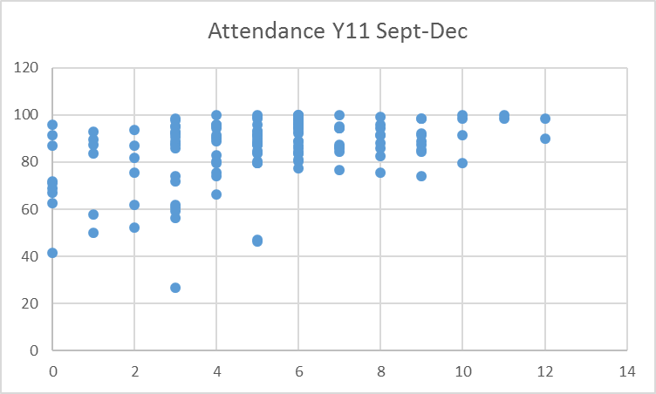
Expectations – Attendance 2022:
There was a 30 percentage points difference in performance at grade 44 between pupils with above 90% attendance compared to those below 90%
At grade 55 this difference was nearly 20%.
Poor attendance leads to low outcomes

Slide 53
Expectations – Attendance 2023:
GROUP | 9-7 | 9-5 | 9-4
All | 3.8 | 21.4 | 42.0
97% + | 25.0 | 75.0 | 87.5
90-96.9% | 6.1 | 31.7 | 56.1
Sub 90% | 0.5 | 10.1 | 26.4
Pupils who come to school regularly will do well in Science.

Slide 54
Expectations – Revision:
Do:
Little and often
Spaced revision
Avoid distractions
Quizzing / retrieval practice
Have a timetable
Avoid:
Prolonged periods of revision
Cramming
Listening to headphones!
Aimlessly re-reading / highlighting
Spending hours making a timetable you don’t stick to

Slide 55
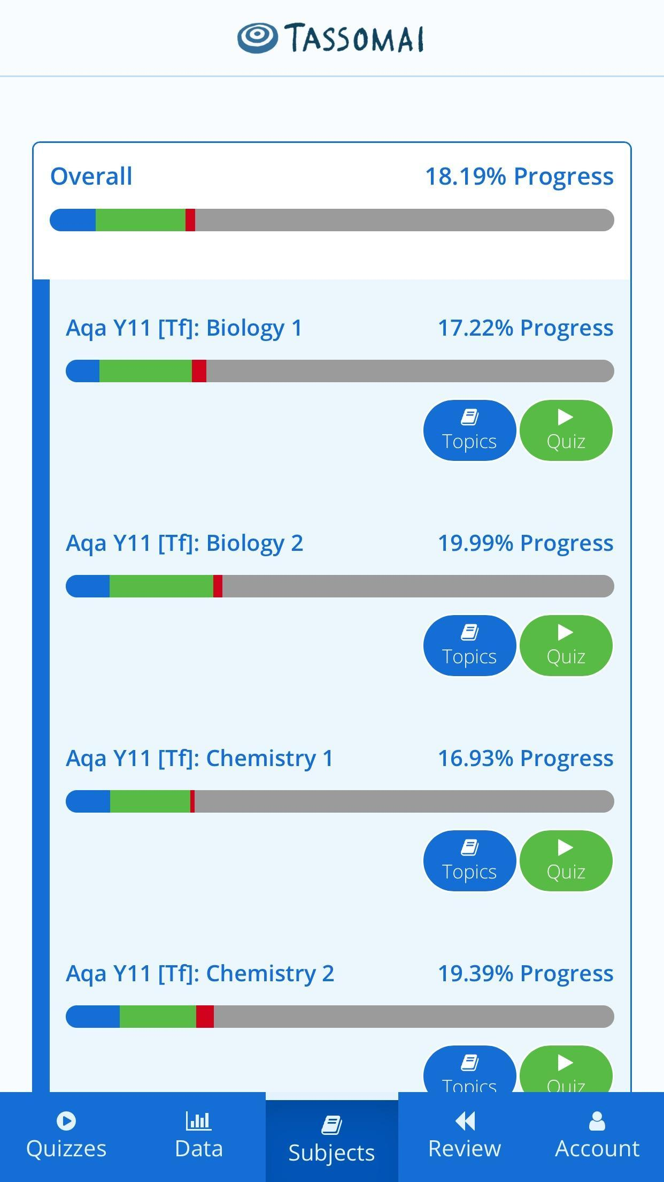
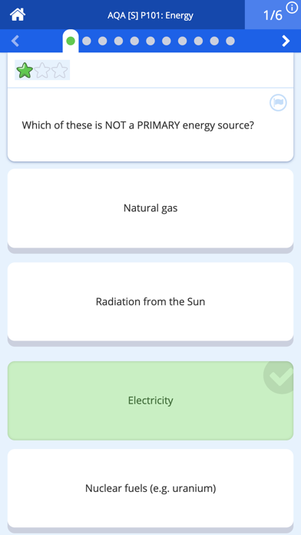
Expectations – Tassomai:
You do:
Regular use – 4 daily goals per week
Students and parents review subjects together
We do:
Use the data to inform interventions
Use the data to determine revision classes and prepare for mocks

Slide 56
Expectations – Tassomai 2019:
Tassomai works!
The school has levelled the playing field by purchasing an account for EVERY pupil.
Every pupil can improve their accuracy by using it more often!
Low accuracy leads to low outcomes

Slide 57
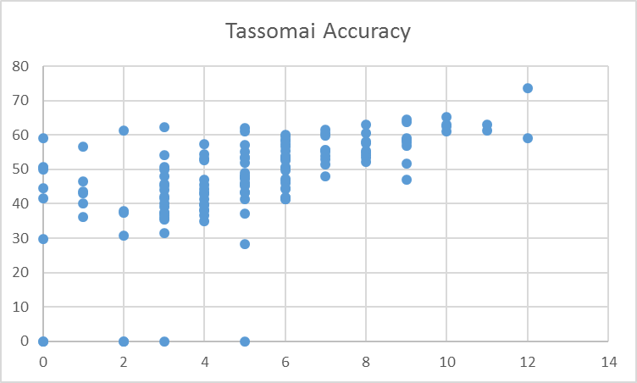
Expectations – Tassomai 2022:
This was again observed during the 2022 exams
Pupils can improve their accuracy and therefore their outcomes!
Low accuracy leads to low outcomes

Slide 58
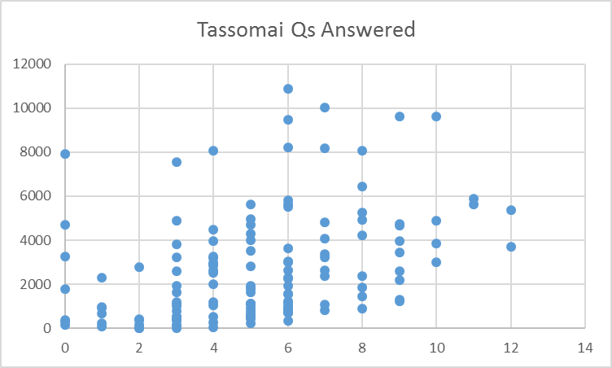
Expectations – Tassomai 2022:
Low effort leads to low outcomes

Slide 59
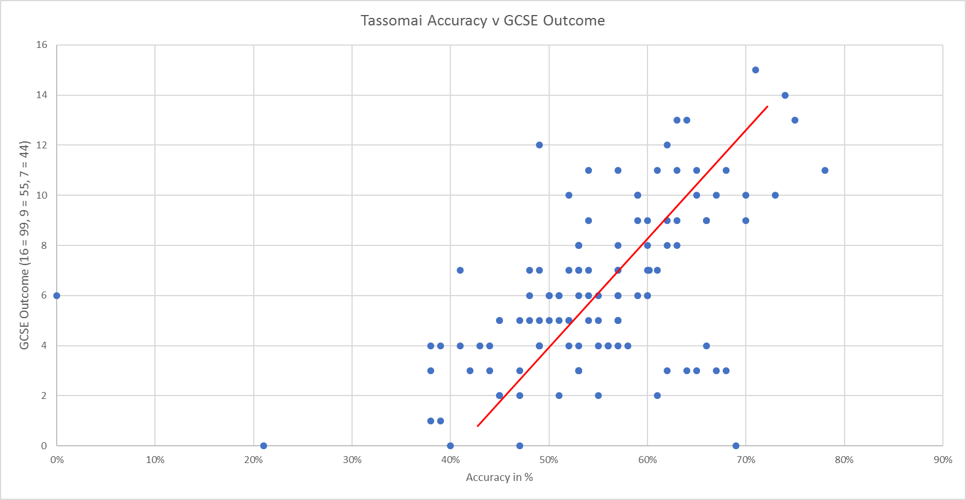
Expectations – Tassomai 2023:
Low accuracy leads to low outcomes
And again in the 2023 exams!

Slide 60
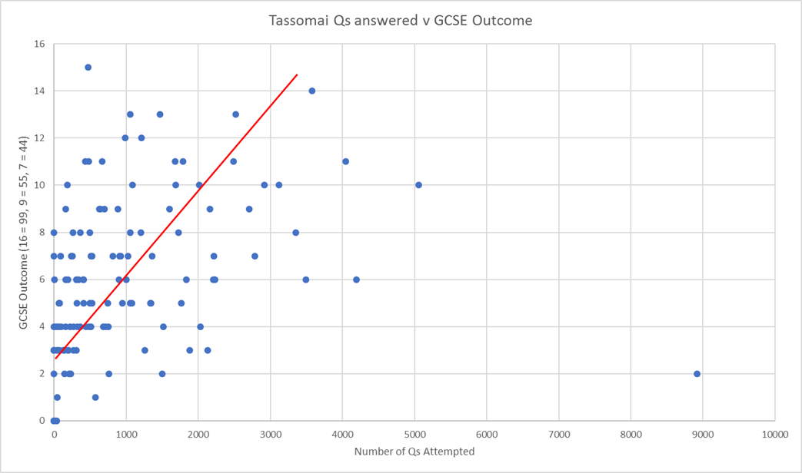
Expectations – Tassomai 2023:
Low effort leads to low outcomes

Slide 61
YouTube
What:
Playlists for all papers
Required practicals
3-4 minutes long
Concise in terms of the knowledge required
How:
Watch and write down the key points.
Self-quiz.

Slide 62
Supporting learning summary
Pupil:
Tassomai – 4 daily goals each week
YouTube – ‘My Free Science Lessons’ channel
Revision guides – Quizzing
School:
Tutor Time Intervention – Tuesday to Friday
After school revision – Week A Monday
Links:
BBC Bitesize - http://www.bbc.co.uk/education/ subjects/zrkw2hv
AQA Combined Science homepage - http://www.aqa.org.uk/subjects/science/gcse/combined-science-trilogy-8464

Slide 63
Finally
If we all work together this year as parents and staff we will achieve so much for your children
We have to be on the same page to support each other
If the team works the dream works
If you have any specific questions please speak to staff at the end or email directly
k.cleary@gateacre.org - English
l.martin@gateacre.org - Mathematics
d.gash@gateacre.org - Science

