Slide 1
Y11 Parents Information Evening Mr P.Creed

Slide 2
Format for the Evening
Introduction Mr Jones
Exams and Support – Mr Creed
Head of Year – Mss Woods
Maths – Mr Martin
English – Mrs Cleary
Science – Mr Gash

Slide 3
Information
This power point slide show will be available on the website tomorrow.

Slide 4
The National Context
Demands of the examinations – Changes over the past 5 years.
Longer exams in all subjects.
More exam papers for a number of subjects.
The application of knowledge NOT just factual recall.
Longer pieces of writing.
An emphasis on technical terms and high level language.

Slide 6
Intervention Sessions - Targeted
English, Maths and Science Intervention classes run each morning Monday – Thursday 8.40am-9.10am.
Good attendance and punctuality is essential in order to gain the most from the sessions.
All intervention classes are targeted to key students who have specific gaps in knowledge so we can fill the gaps.
Intervention classes are not just general revision as one size does not fit all.
After 6 weeks a new cohort of students will be invited, this format will continue all year.
If your child has not been selected this time they may well be next time or not at all if they don’t need it.

Slide 7
Y11 Study Support
Each morning Y11 students are encouraged to attend school early at 8am to study in the atrium.
An area will be cordoned off just for studying.
A free breakfast will be provided each day.
Teaching staff will be on hand to support the students.
Departments will provide resources and revision materials.
This is will start tomorrow morning and run until the mock exams initially.

Slide 8
After School Revision
We hope to launch our after school revision class timetable within the next 2 weeks.
Students will be able to see which classes are available on which days.
It will be a 2 week timetable. E.g. English week one, Maths the second week.
Students are strongly advised to attend so that they are revisiting material from last year, which they may have forgotten.
I will contact you when we are ready to go live.

Slide 9
Mock Exams
Mocks - November 21st – 1st December.
Mock results Thursday 15th December 3.05pm.

Slide 10
Head of Year 11
Miss Woods

Slide 11
Year 11 HOY/Pastoral
Attendance. Every school day really does count. Research will tell you that by not being in everyday will affect your overall grade and outcomes.
Punctuality-Being late to lessons disrupts the learning of other students and hinders the flow of the lessons.
After School Revision Sessions-Students to start as early as possible.
Revision timetable at home.
Interventions are on-going and take place during Academic Tutor Time
GCSE Pod/PIXL other Apps/websites
Getting Basics Right-Being equipped and ready to learn
Pastoral Support – HOY/AHOY/Form Tutors. We are here for you!
End of year celebrations.

Slide 12
Year 11 HOY/Pastoral
Pastoral support
HOY/AHOY
Form tutors
Subject staff
Additional services – counselling /YPAS
Working collaboratively with each other to support and guide your child.

Slide 13
Mr Martin Head of Mathematics

Slide 14
GCSE Mathematics
EDUQAS exam board
Full details of their specification can be found on www.eduqas.co.uk
2 examinations at the end of year 11
Foundation (1-5) and Higher Tier (3-9)

Slide 15
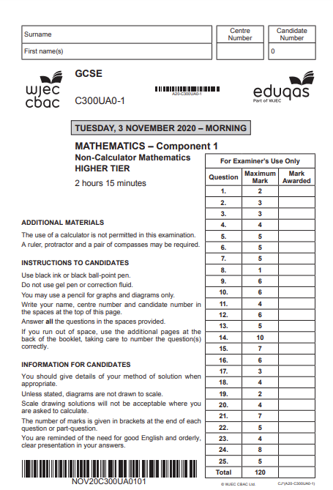
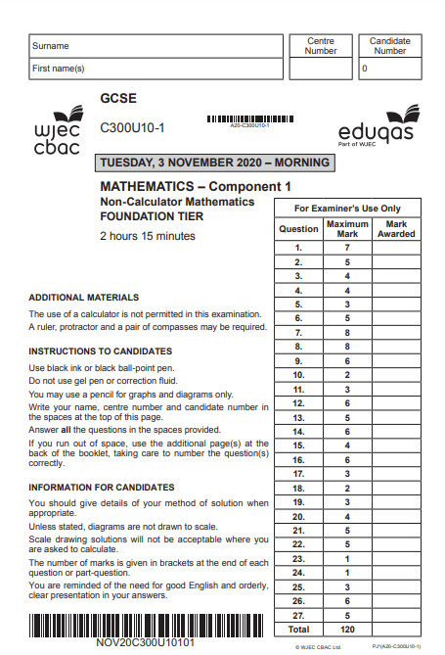
Examinations
Both papers will be marked out of 120
Both will be 2 hours 15 minutes
Both will be a mixture of topics
About 30% crossover topics
Dates TBC

Slide 16
How you can help at home:
Attendance! Attendance! Attendance!
Maths figures last year:
All Students 56.4% 9-4
Students with attendance over 90% 80.4% 9-4
Students with attendance over 96% 100% 9-4
If your son/daughter is selected for an intervention class please ensure they are in school on time for the intervention.

Slide 17
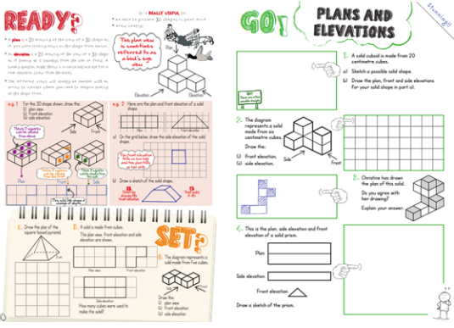
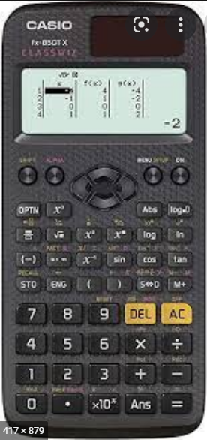
How you can help at home:
Encourage and monitor use of Hegarty Maths at home
Can see what the students have been working on by looking at their account HegartyMaths Help Pages
Encourage use of revision guide at home and before/after school (we are in the process of buying every student one of these)
Quiz your child on definitions, times tables etc and help them keep track of (and celebrate!) their progress
Encourage and monitor use of mock revision booklets (students already have these)
2 or 3 twenty minute sessions per week to begin with.
Ask them about topics they need to work on from their weekly Retrieval Quizzes in class.
Provide a quiet place for them to work independently at home.
Ensure homework is done each week.
Purchase a calculator Casio fx-85gtx (about £12)
Please consult us before thinking about a tutor!

Slide 18
Additional support available in school
Targeted morning intervention classes.
Targeted one to one meetings.
Additional support from members of the maths department (doesn’t have to be their teacher!)
Weekly after school revision on a Wednesday.
Whole department exam practice from January.

Slide 19
Supporting learning
Hegarty Maths
Revision guide
GCSE Pod – Password access for each pupil
Corbett Maths website – free resource
BBC Bitesize - http://www.bbc.co.uk/education/subjects/zrkw2hv
Dr Frost Maths website – free resource

Slide 20
Y11 Parents Information Evening
GCSE English Language & GCSE English Literature

Slide 21
Y 11 English
Your child is being prepared for 2 GCSE qualifications in English lessons: GCSE English Language and GCSE English Literature.
We follow EDUQAS specifications. You can access full details of the exam syllabus for each qualification on their website www.eduqas.co.uk
Results will reported on the 1-9 grading system, introduced for English qualifications in August 2017.

Slide 22
GCSE English Language Summary of Assessment
2 examinations (1 x 1 hour 45 minutes; 1 x 2 hours)
1 compulsory spoken language presentation
No centre assessed written coursework or controlled assessment
Skills based assessment – all texts are unseen
Mock examination in November 2017

Slide 26
GCSE English Literature Summary of Assessment
2 examinations (1 x 2 hours; 1 x 2 hours 30 minutes)
No centre assessed written coursework or controlled assessment
Knowledge and skill-based assessment
Mock examination in March 2018
4 set texts:
Macbeth, William Shakespeare
An Inspector Calls, J B Priestley
The Strange Case of Dr Jekyll and Mr Hyde, Robert Louis Stevenson
EDUQAS Anthology of poetry

Slide 27
Section A (20%) Shakespeare
Set Text: Macbeth
One extract question and one essay question based on the reading of a Shakespeare
Learners are not permitted to take copies of the set texts into the examination.
Section B (20%) Poetry from 1789 to the present day
Two questions based on poems from the WJEC Eduqas Poetry Anthology, one of which involves comparison.
Learners are not permitted to take a copy of the anthology into the examination.

Slide 28
Section A (20%) Post-1914 Prose/Drama
One source-based question on a post 1914 prose/drama text
Set text: An Inspector Calls (Priestley)
Learners are not permitted to take copies of the set texts into the examination.
Section B (20%) 19th Century Prose
One source-based question on a 19th century prose text
Set text: The Strange Case of Dr Jekyll and Mr Hyde (Stevenson)
Learners are not permitted to take copies of the set texts into the examination.
Section C (20%) Unseen Poetry from the 20th/21st Century
Two questions on unseen poems, one of which involves comparison.

Slide 29
How can I help at home?
Ensure good punctuality and attendance.
Read the set texts and discuss them with your child.
Watch film adaptations of the set texts together.
Provide a quiet place to work and revise.
Try to help develop healthy routines that allow for both study and leisure time, including rest and sleep.
Encourage your child to read widely from a range of fiction and non-fiction texts. Newspapers, magazines and leaflets, which you may have at home, are a great source of material for revising how to write articles, leaflets and guides.
Proof-read homework together to check for errors in spelling, punctuation and grammar.
Help compile a list of words your child has difficulty spelling and test regularly.

Slide 30
Help draw up a realistic revision plan (see department suggestions).
Look through revision materials together
Help with the memorising of quotations from the set texts
Condense notes onto flash cards to act as revision prompts.
Time your child's attempts at practice exam tasks, past papers.

Slide 31
Additional support available in school
Department revision materials and recommended revision schedule
Weekly teacher assigned Educake quizzes
Targeted morning intervention classes
Targeted one-to-one intervention with Subject Leader
Class teacher interventions
Student GCSE Pod account
After school revision sessions

Slide 32
Useful Websites
https://www.gcsepod.com
https://www.educake.co.uk/
https://www.bbc.co.uk/bitesize/examspecs/zpxh82p
(GCSE English Language)
https://www.bbc.co.uk/bitesize/examspecs/zw9mycw
(GCSE English Literature)
http://www.sparknotes.com/

Slide 33
Mr Gash Head of Science
d.gash@gateacre.org

Slide 34
GCSE Combined Science
AQA GCSE Combined Science: Trilogy
6 examinations at the end of Y11.
It is worth 2 GCSEs so they should spend twice as much time on it!
Separate Sciences – 3 Separate Single Grades 9-1. - AQA GCSE Biology - AQA GCSE Chemistry - AQA GCSE Physics

Slide 35
GCSE Science Exams
Combined Science Higher tier – Grades 4-3 upwards Foundation – Grades 5-5 downwards
Separate Sciences Higher Tier – Grade 4 upwards Foundation – Grade 5 downwards

Slide 36
Examinations
External Science exams are likely to start sometime at the end of May or early June.
Each paper is 75 minutes long (1h 45 mins for SS) and is marked out of 70 marks (100 marks for SS).
Each paper will assess the pupils ability to ‘work scientifically’ (15% of questions) and use Numeracy effectively (20% of questions).

Slide 37
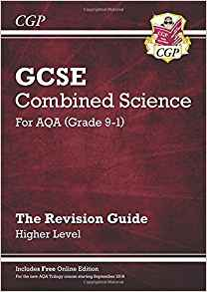
Expectations – every pupil must:
Use their revision guides! Self quizzing, practice questions, flash cards (using them, not just making them!)
Attend 100% of the time and be punctual 100% of the time. If absent the pupil must take responsibility for catching up on both class work and home work.
Complete their Tassomai “Daily goal” 4 times each week.

Slide 38
Expectations – Attendance 2019:
Only 1 pupil with an attendance below 85% scored a grade 5-4 or higher (circled in blue).
Only 1 pupil with an attendance below 80% scored a grade 4-4 or higher (circled in red).

Slide 39
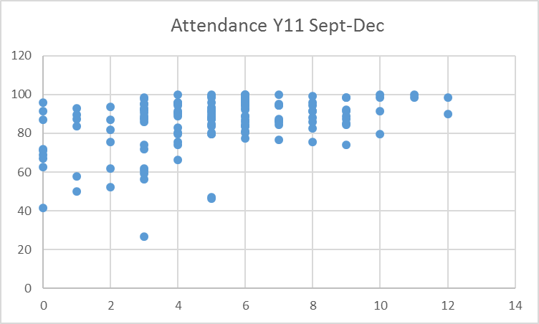
Expectations – Attendance 2022:
There was a 30 percentage points difference in performance at grade 44 between pupils with above 90% attendance compared to those below 90%
At grade 55 this difference was nearly 20%.
Poor attendance leads to low outcomes

Slide 40
Expectations – Revision:
Do:
Little and often
Spaced revision
Avoid distractions
Quizzing / retrieval practice
Have a timetable
Avoid:
Prolonged periods of revision
Cramming
Listening to headphones!
Aimlessly re-reading / highlighting
Spending hours making a timetable you don’t stick to

Slide 41
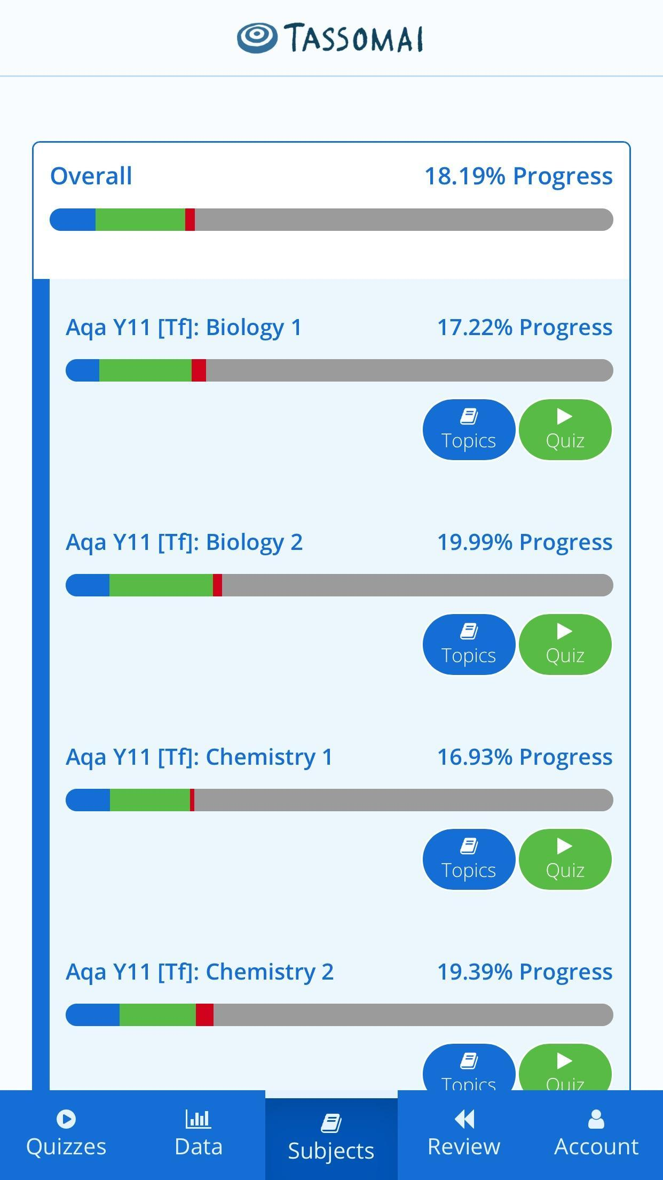
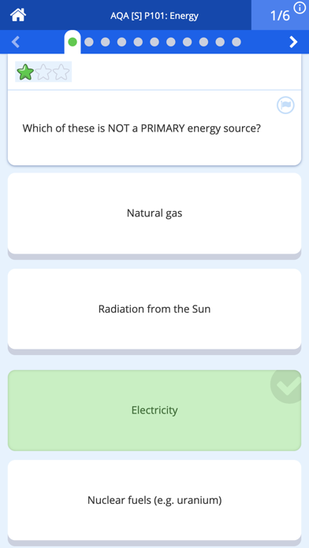
Expectations – Tassomai:
You do:
Regular use – 4 daily goals per week
Students and parents review subjects together
We do:
Use the data to inform interventions
Use the data to determine revision classes and prepare for mocks

Slide 42
Expectations – Tassomai 2019:
Tassomai works!
The school has levelled the playing field by purchasing an account for EVERY pupil.
Every pupil can improve their accuracy by using it more often!
Low accuracy leads to low outcomes

Slide 43
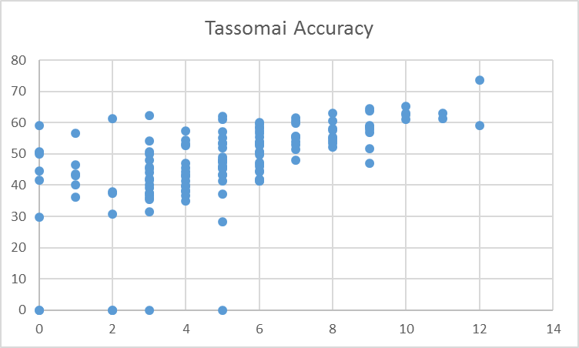
Expectations – Tassomai 2022:
This was again observed during the most recent 2022 exams
Pupils can improve their accuracy and therefore their outcomes!
Low accuracy leads to low outcomes

Slide 44
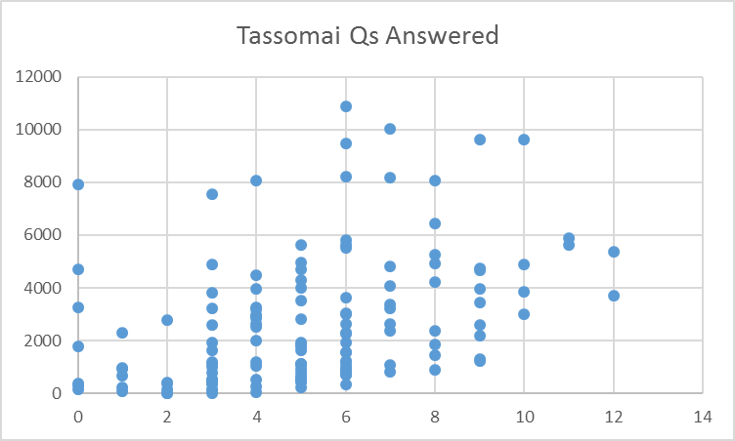
Expectations – Tassomai 2022:
Low effort leads to low outcomes

Slide 45
YouTube
What:
Playlists for all papers
Required practicals
3-4 minutes long
Concise in terms of the knowledge required
How:
Watch and write down the key points.
Self-quiz.

Slide 46
Supporting learning summary
Tassomai
YouTube – ‘My Free Science Lessons’ channel
GCSE Pod – Password access for each pupil
W/Drive – student access to lesson resources
Revision guides
Tutor Time Intervention – Mon-Wed
BBC Bitesize - http://www.bbc.co.uk/education/subjects/zrkw2hv
AQA Combined Science homepage - http://www.aqa.org.uk/subjects/science/gcse/combined-science-trilogy-8464

Slide 47
Finally
If we all work together this year as parents and staff we will achieve so much for your children
We have to be on the same page to support each other
If the team works the dream works
If you have any specific questions please speak to staff at the end or email directly
k.cleary@gateacre.org - English
l.martin@gateacre.org - Mathematics
d.gash@gateacre.org - Science

